Slide 1
Simply Siam Online Ordering System (WebApp)
By
Akshay Reddy Vontari
Bala Krishna Vijayagiri
Kranthi Kumar Parelly
Shiva Teja Miyapuram
Tarun Kumar PotlapallI
Sai Nithin Reddy Muppidi

Slide 2
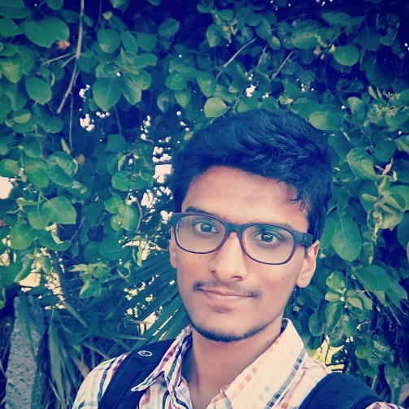
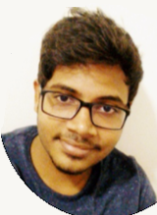
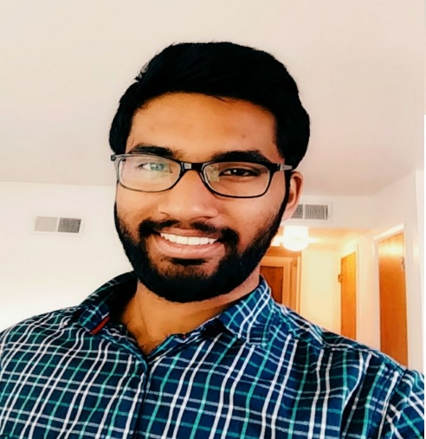
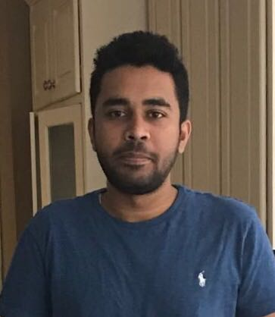
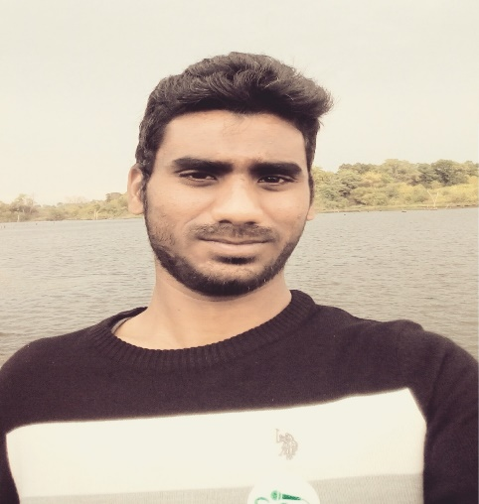
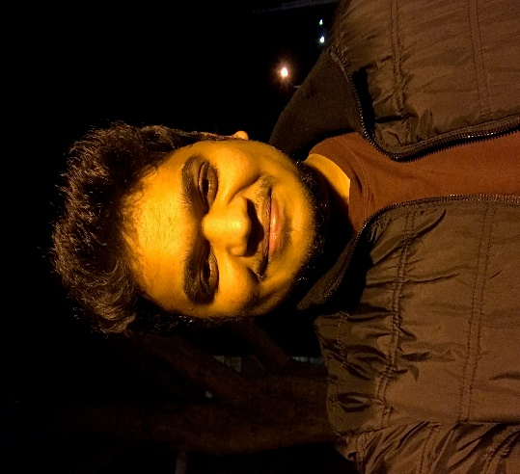
Team Members:
Tarun Kumar Potlapalli
Shiva Teja Miyapuram
Akshay Reddy Vontari
Sai Nithin Reddy Muppidi
Bala Krishna Vijayagiri
Kranthi Kumar Parelly

Slide 3
Content
Introduction
Objectives
Tools
Technologies
Design
Reached and not reached objectives
Challenges
Lessons Learned
Acknowledgments

Slide 4
Introduction
A website for Simply Siam restaurant
Existing System
Paper based orders
Phone call orders
Purposed System
Web based application which helps customers to make orders online for dine-in and take-away
Provides restaurant management an interface to keep track of their orders
Provides feedback about website and static menu
Can be accessed by any device with a browser
Notes:
Used to manage the information of all the users using this system

Slide 5
Objectives
Front page
Login page
Menu page
Ordering Page
Cart page
Place order page
Confirmation page
Testing
Training

Slide 6





Tools
NodeJS
Robo 3T
Bitbucket
Visual Studio Code
Git

Slide 7






Technologies
HTML 5
JavaScript
CSS 3
Bootstrap
HandleBarsJS
MongoDB

Slide 8
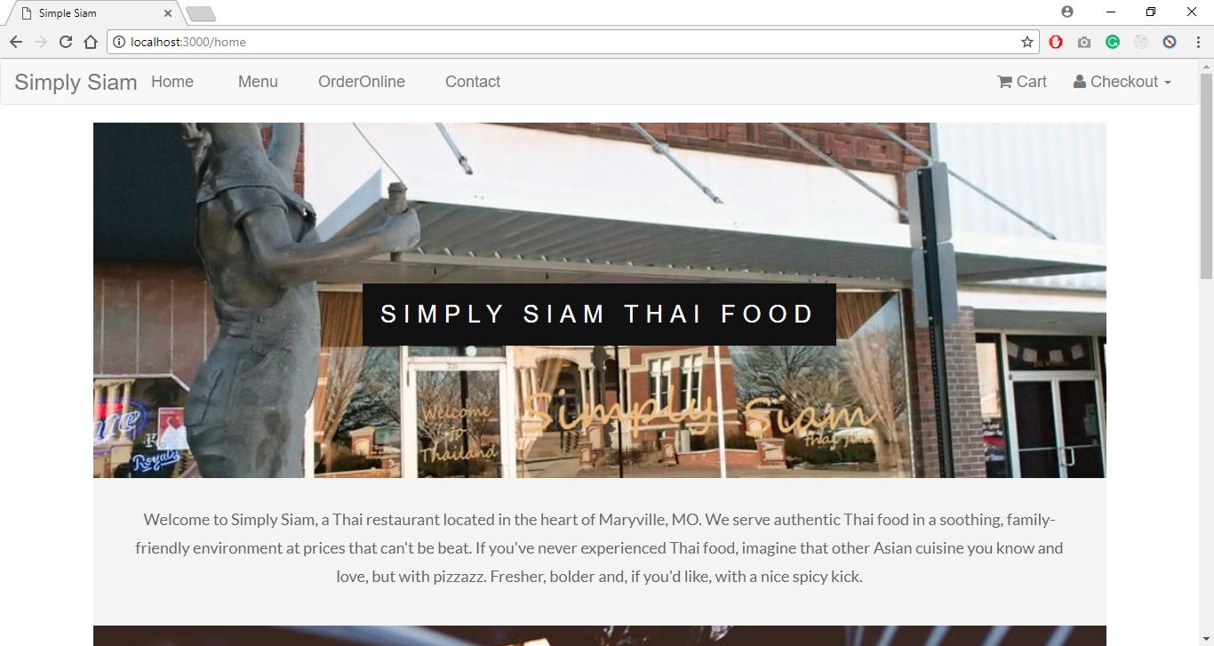
Design : Home Page

Slide 9
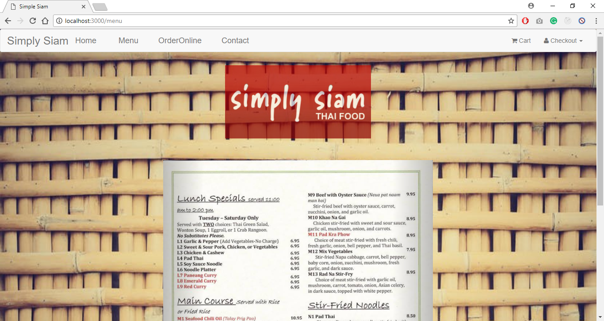
Menu Page

Slide 10
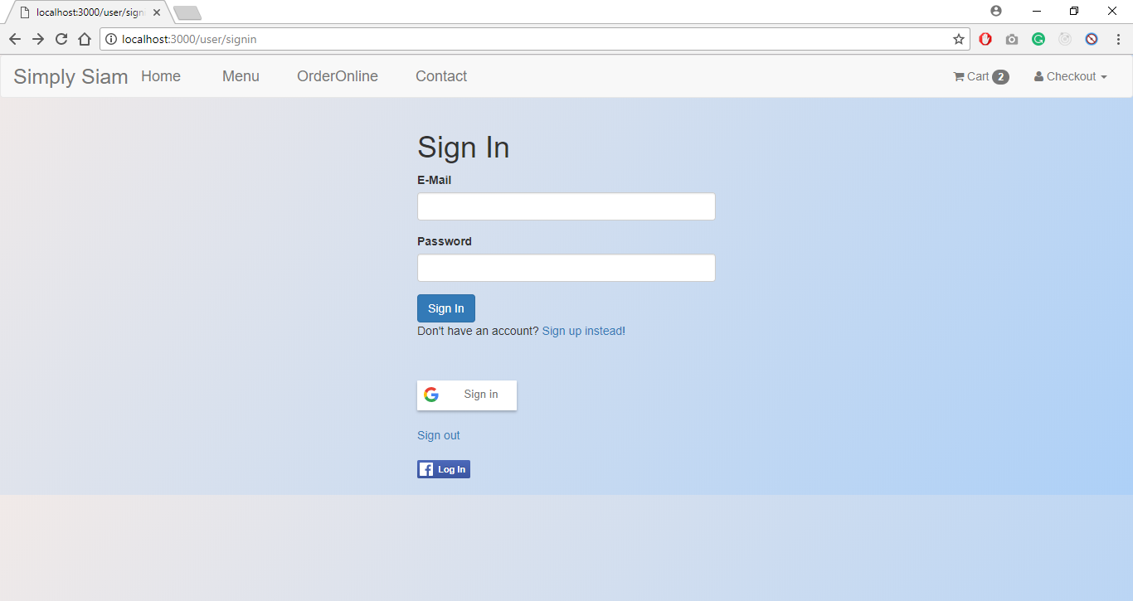
Sign In Page

Slide 11
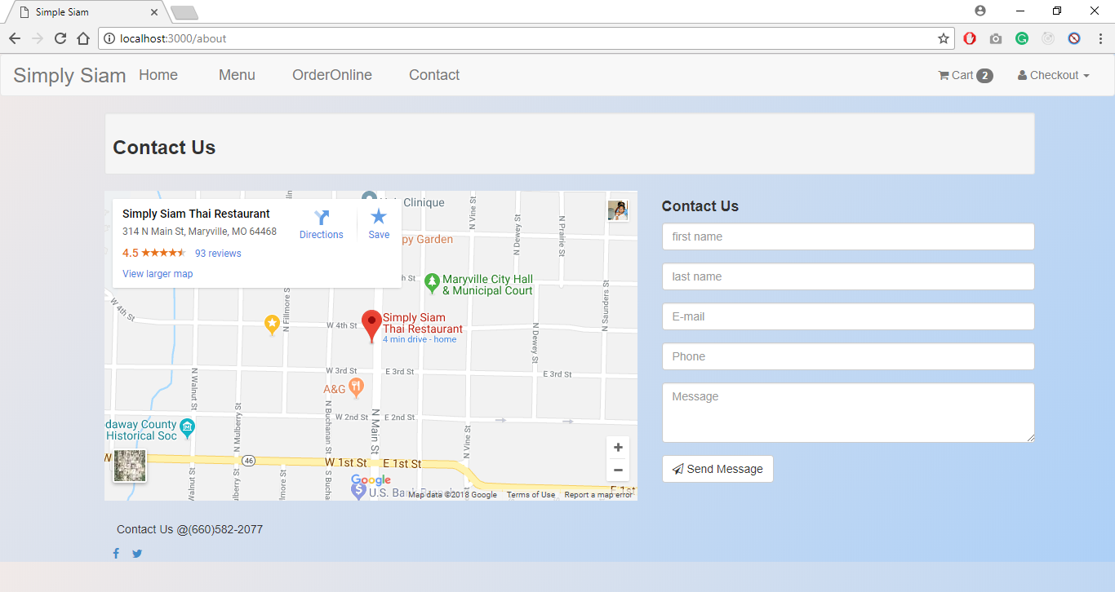
Contact Page

Slide 12
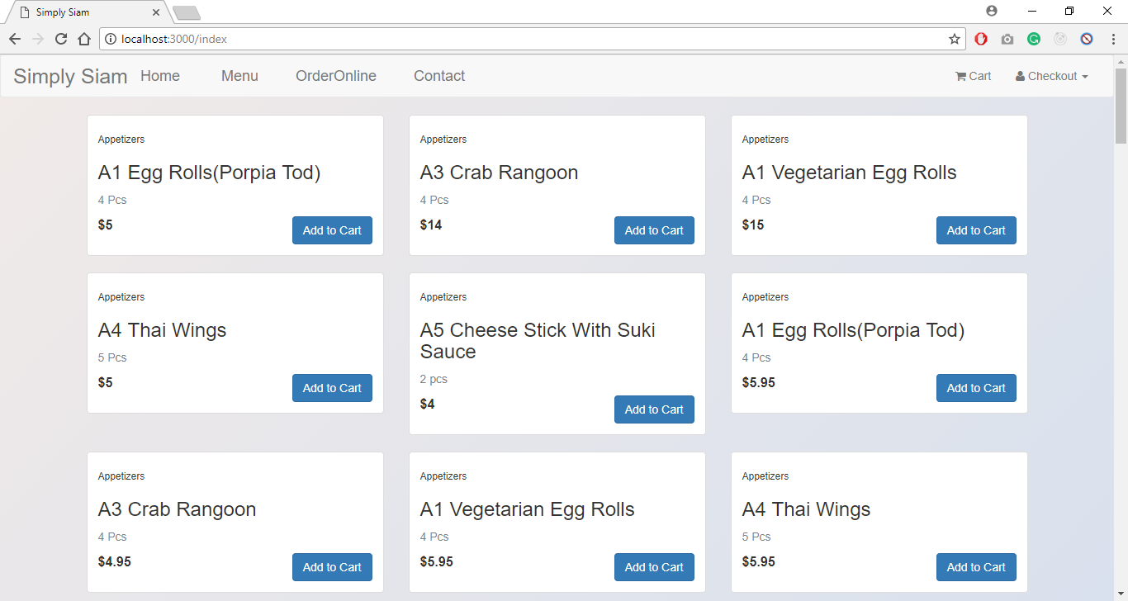
Online Order Menu Page

Slide 13
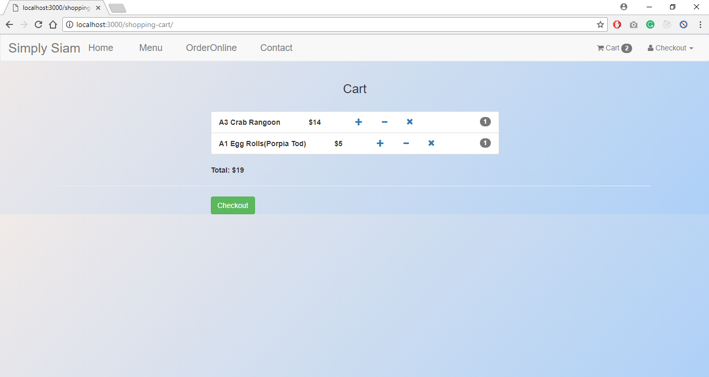
Cart Page

Slide 14
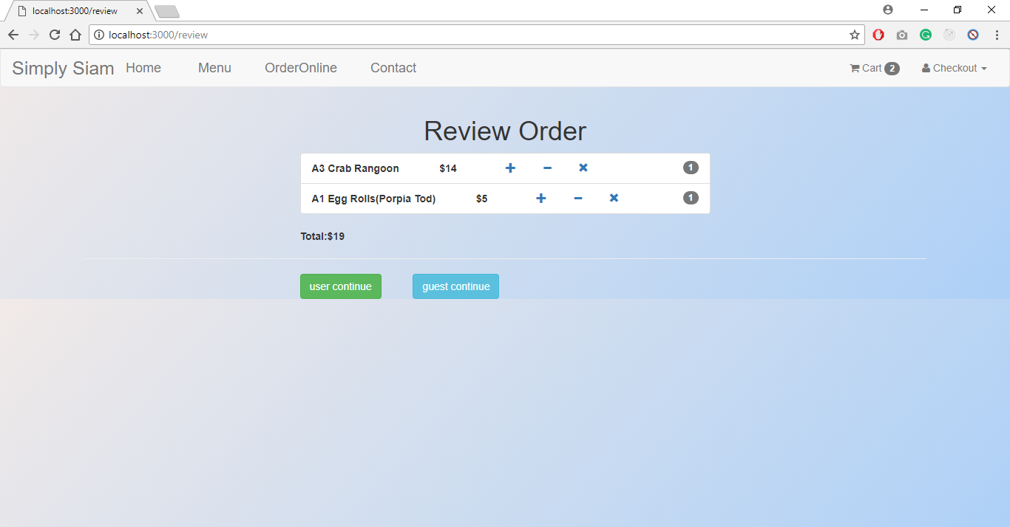
Review Order Page

Slide 15
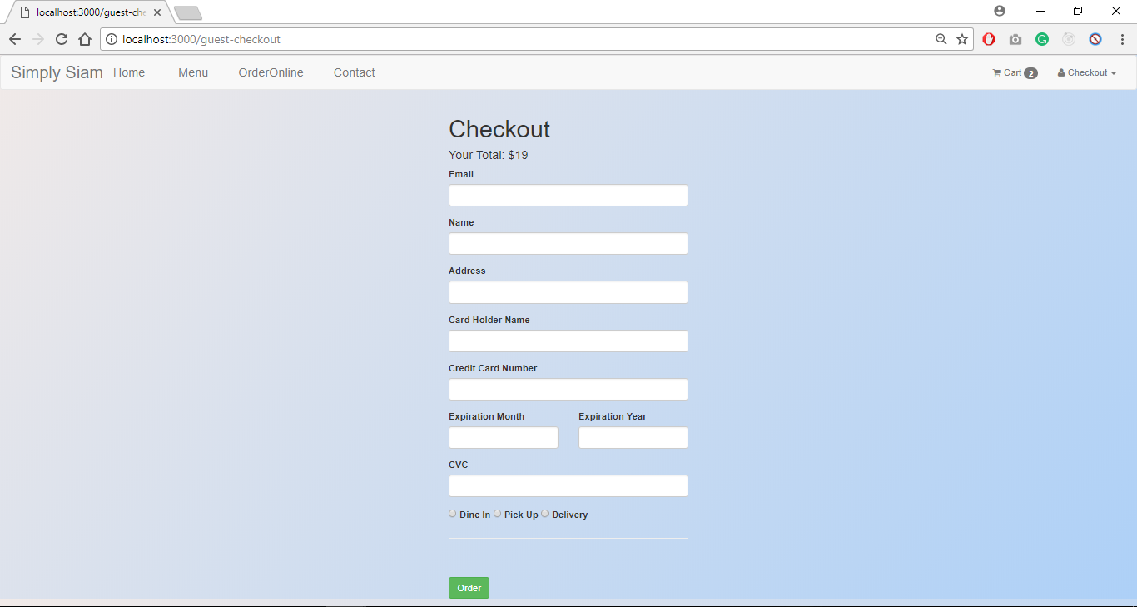
Checkout

Slide 16
Reached Objectives
Objectives reached in GDP-1
Home Page
Navigation Bar
Menu Page
Dine-in
Delivery
Registration and login with email
Contact Page
Map Integration

Slide 17
Reached Objectives
Objectives reached in GDP-2
Menu Page
Static Menu
Online Order Menu
Cart page
Review cart
Login page
Signup page
User profile page
Checkout Page
Guest
User
Credit charge

Slide 18
Not Reached Objectives
Order confirmation email
Social media sign in

Slide 19
Challenges
Merge conflicts
Data retrieving from database
Database integration
Sending confirmation email
Adding the items to the cart
Implementing the sessions for the users

Slide 20
Lessons Learned
Plan how to do before implementing the code
Coordinating with team members with the project meeting
Working with NodeJS, ExpressJs, Bitbucket, Robo 3T..etc
Retrieving the data
Meeting the deadlines.

Slide 21
Acknowledgements
We would like to thank
Simply siam thai food management
Dr. Zhengrui, Qin

Slide 22


Slide 23


Slide 24
Team Members:
Tarun Kumar Potlapalli
Shiva Teja Miyapuram
Akshay Reddy Vontari
Sai Nithin Reddy Muppidi
Bala Krishna Vijayagiri
Kranthi Kumar Parelly

